Slide 1
Voting Demo
By Rizal Mohd Nor

Slide 2
Agenda
Architecture
Dev Setup
Voting Contract
Smart Contract in Solidity
Compile the smart contract
Deploy the smart contract to blockchain
Interact with solidity contract in nodejs console
Interact with solidity contract in web browser

Slide 3
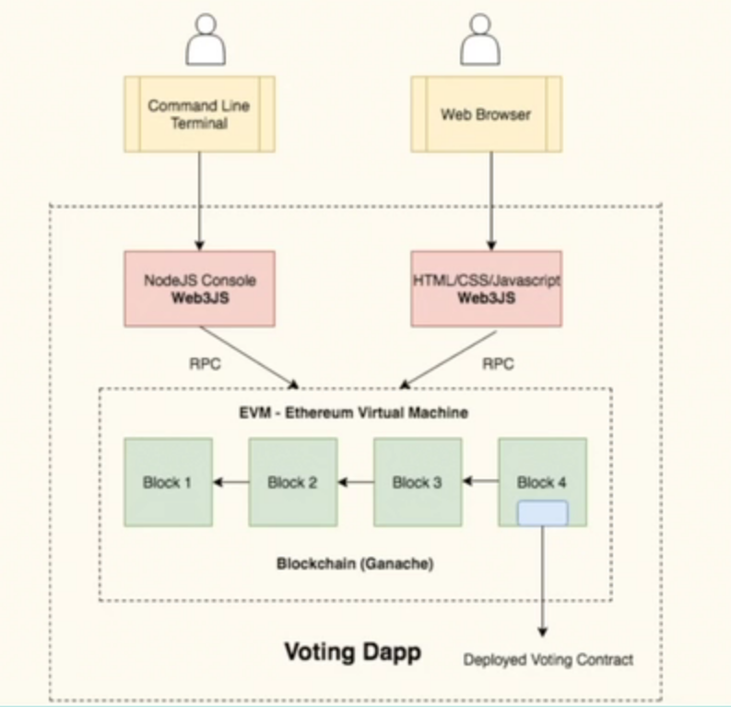
Architecture

Slide 4
Dev Setup
Install Visual Studio Community Edition. If you choose a custom installation, the bare minimum items that need to be checked are all pertaining to Visual C++ (Current version is VS 2019)
Install the Windows SDK for Windows
Install Python 2.7 if not already installed, and make sure to add its install location to your PATH
Install git if you don't have it and add it to your PATH
Install OpenSSL from here. Make sure to choose the right package for your architecture, and only install the full package (not the light version). You must install OpenSSL at its recommended location — do not change the install path
Download and install node v12.15

Slide 5
Voting Contract – Smart Contract in Solidity
At windows start, run PowerShell administrator mode
npm install windows-build-tools
npm install ganache-cli web3 solc
And the prompt->
node_modules/.bin/ganache-cli.cmd

Slide 6
Compile the smart contract
Compile:
node_modules/.bin/solcjs --bin --abi Voting.sol
[windows] - > .\node_modules\.bin\solcjs.cmd –bin –abi Voting.sol
Make sure you have compiled it, run:
ls
Voting.sol Voting_sol_Voting.bin index.js package-lock.json
Voting_sol_Voting.abi index.html node_modules
View the files:
cat Voting.sol
cat Voting_sol_Voting.bin
cat Voting_sol_Voting.abi

Slide 7
Deploy the smart contract to blockchain using node
> bytecode = fs.readFileSync(‘./Voting_sol_Voting.bin').toString()
> abi = JSON.parse(fs.readFileSync('./Voting_sol_Voting.abi').toString())
> Web3 = require('web3')
> web3 = new Web3("http://localhost:8545")
> deployedContract = new web3.eth.Contract(abi)
> web3.eth.getAccounts(console.log) <- Should output 10 accounts
> listOfCandidates = ['Rama', 'Nick', 'Jose']
deployedContract.deploy({
data: bytecode,
arguments: [listOfCandidates.map(name => web3.utils.asciiToHex(name))]
}).send({
from: '0xE7D1Fb6c79d51372eCB69A16BDFb19820C568100',
gas: 1500000,
gasPrice: web3.utils.toWei('0.00003', 'ether')
}).then((newContractInstance) => {
try {
deployedContract.options.address = newContractInstance.options.address
console.log(newContractInstance.options.address)
} catch(err) {
next(err);
}
}) > deployedContract.options.address

Slide 8
Interact with solidity contract in nodejs console
deployedContract.methods.totalVotesFor(web3.utils.asciiToHex('Rama')).call().then((count) => console.log(count))
Output
Promise { <pending> }
> 0
// Lets Vote for a Candidate
> deployedContract.methods.voteForCandidate(web3.utils.asciiToHex('Rama')).send({from: '0xE7D1Fb6c79d51372eCB69A16BDFb19820C568100'}).then((f) => console.log(f))
>
// Now check again how many votes you have for Rama and others

Slide 9
Interact with solidity contract in web browser
//Writing a front end for the voting app
// first we need the ABI
Just open the ABI in your folder and copy and paste it the index.js
// then you need the contract address, you can get the deployed contract address by calling
> deployedContract.options.address // in your node console
Open the index.html in a web page

